Slide 1
Fault Tolerance in
Distributed Systems

Slide 2
Fault Tolerant
Distributed Systems
ICS 237
Prof. Nalini Venkatasubramanian
(with some slides modified from Prof. Ghosh, University of Iowa and Indranil Gupta, UIUC)

Slide 3
Fundamentals
What is fault?
  A fault is a blemish, weakness, or shortcoming of a particular hardware or software component.
  Fault, error and failures
Why fault tolerant?
  Availability, reliability, dependability, …
How to provide fault tolerance ?
  Replication
  Checkpointing and message logging
  Hybrid

Slide 4
Reliability
Reliability is an emerging and critical concern in traditional and new settings
  Transaction processing, mobile applications, cyberphysical systems
New enhanced technology makes devices vulnerable to errors due to high complexity and high integration
  Technology scaling causes problems
    Exponential increase of soft error rate
  Mobile/pervasive applications running close to humans
    E.g Failure of healthcare devices cause serious results
  Redundancy techniques incur high overheads of power and performance
    TMR (Triple Modular Redundancy) may exceed 200% overheads without optimization [Nieuwland, 06]
Challenging to optimize multiple properties (e.g., performance, QoS, and reliability)
Notes:
Reliability issue is emerging and its optimization is challenging due to tradeoffs among multiple properties!

Slide 5
Classification of failures
Crash failure
Security failure
Omission failure
Temporal failure
Byzantine failure
Transient failure
Software failure
Environmental perturbations

Slide 6
Crash failures
Crash failure = the process halts. It is irreversible.
In synchronous system, it is easy to detect crash failure (using heartbeat signals and timeout). But in asynchronous systems, it is never accurate, since it is not possible to distinguish between a process that has crashed, and a process that is running very slowly.
Some failures may be complex and nasty. Fail-stop failure is a simple abstraction that mimics crash failure when program execution becomes arbitrary. Implementations help detect which processor has failed. If a system cannot tolerate fail-stop failure, then it cannot tolerate crash.

Slide 7
Transient failure
(Hardware) Arbitrary perturbation of the global state. May be induced by power surge, weak batteries, lightning, radio-frequency interferences, cosmic rays etc.
(Software) Heisenbugs are a class of temporary internal faults and are intermittent. They are essentially permanent faults whose conditions of activation occur rarely or are not easily reproducible, so they are harder to detect during the testing phase.
Over 99% of bugs in IBM DB2 production code are non-deterministic and transient (Jim Gray)
Not Heisenberg

Slide 8
Temporal failures
Inability to meet deadlines – correct results are generated, but too late to be useful. Very important in real-time systems.
May be caused by poor algorithms, poor design strategy or loss of synchronization among the processor clocks

Slide 9
Byzantine failure
Anything goes! Includes every conceivable form of erroneous behavior. The weakest type of failure
Numerous possible causes. Includes malicious behaviors (like a process executing a different program instead of the specified one) too.
Most difficult kind of failure to deal with.

Slide 10

Errors/Failures across system layers
Faults or Errors can cause Failures
Bug
Application
Packet
Loss
Middleware/ OS
Network
Exception
Hardware
Soft
Error
Notes:
Mobile device is composed of system abstraction layers such as app, mw, os, and hw, and it is communicating via wireless connection.
There exist different types of errors and faults as shown in this diagram.
Let’s take a look at those errors and failures, and their protection techniques at each system abstraction layer.

Slide 11
Hardware Errors and Error Control Schemes
Failures | Causes | Metrics | Traditional Approaches
Soft Errors, Hard Failures, System Crash | External Radiations, Thermal Effects, Power Loss, Poor Design, Aging | FIT, MTTF, MTBF | Spatial Redundancy (TMR, Duplex, RAID-1 etc.) and Data Redundancy (EDC, ECC, RAID-5, etc.)
Hardware failures are increasing as technology scales
  (e.g.) SER increases by up to 1000 times [Mastipuram, 04]
Redundancy techniques are expensive
  (e.g.) ECC-based protection in caches can incur 95% performance penalty [Li, 05]
FIT: Failures in Time (10⁹ hours)
MTTF: Mean Time To Failure
MTBF: Mean Time b/w Failures
TMR: Triple Modular Redundancy
EDC: Error Detection Codes
ECC: Error Correction Codes
RAID: Redundant Array of
Inexpensive Drives
Notes:
There are soft errors, permanent failures and system crash, which result from external radiations such as alpha particles and neutrons, high temperature, battery out, poor design, and aging.
Metrics to measure the reliability for hardware components include FIT, MTTF, and MTBF in general.
FIT standing fro Failures in Time is to measure a number of errors in one billion operation hours.
MTTF indicates how long it takes to meet a failure and MTBF indicates how long it takes from a failure to the next failure.
To recover those failures, we can think about spatial redundancy technique and data redundancy technique.
Spatial redundancy techniques include TMR, duplex, RAID, etc.
Data redundancy includes error detection codes, error correction codes, etc.
These hardware failures increase as technology scales and integration increases. For example, SER increases by several orders of magnitude times every technology.
These redundancy techniques are effective but expensive. For instance, ECC for caches incur up to 95% performance penalty, and up to 22% power overhead. Thus, processors for high reliability protects just L2 and L3 caches, but not L1 cache, since it is so sensitive to processors’ performance and power.

Slide 12

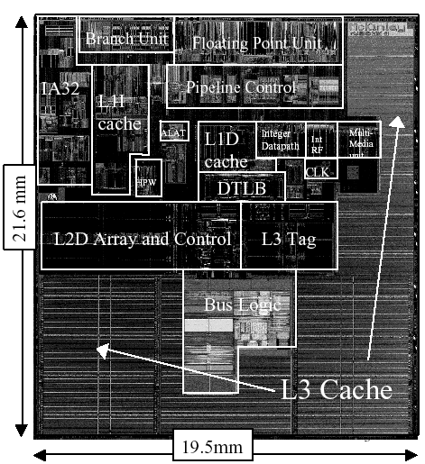
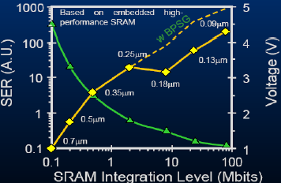

Soft Errors (Transient Faults)
SER increases exponentially as technology scales
Integration, voltage scaling, altitude, latitude
Caches are most hit due to:
  Larger portion in processors (more than 50%)
  No masking effects (e.g., logical masking)
Intel Itanium II Processor
[Baumann, 05]
Transistor
5 hours MTTF
0
1
1 month MTTF
Bit Flip
MTTF: Mean time To Failure

Slide 13
Soft errors
 | SER (FIT) | MTTF | Reason
1 Mbit @ 0.13 µm | 1000 | 104 years
64 MB @ 0.13 µm | 64x8x1000 | 81 days | High Integration
128 MB @ 65 nm | 2x1000x64x8x1000 | 1 hour | Technology scaling and Twice Integration
A system @ 65 nm | 2x2x1000x64x8x1000 | 30 minutes | Memory takes up 50% of soft errors in a system
A system with voltage scaling @ 65 nm | 100x2x2x1000x64x8x1000 | 18 seconds | Exponential relationship b/w SER & Supply Voltage
A system with voltage scaling @ flight (35,000 ft) @ 65 nm | 800x100x2x2x1000x64x8x1000 FIT | 0.02 seconds | High Intensity of Neutron Flux at flight (high altitude)
 | SER (FIT) | MTTF | Reason
1 Mbit @ 0.13 µm | 1000 | 104 years
64 MB @ 0.13 µm | 64x8x1000 | 81 days | High Integration
128 MB @ 65 nm | 2x1000x64x8x1000 | 1 hour | Technology scaling and Twice Integration
A system @ 65 nm | 2x2x1000x64x8x1000 | 30 minutes | Memory takes up 50% of soft errors in a system
 | SER (FIT) | MTTF | Reason
1 Mbit @ 0.13 µm | 1000 | 104 years
 | SER (FIT) | MTTF | Reason
1 Mbit @ 0.13 µm | 1000 | 104 years
64 MB @ 0.13 µm | 64x8x1000 | 81 days | High Integration
 | SER (FIT) | MTTF | Reason
1 Mbit @ 0.13 µm | 1000 | 104 years
64 MB @ 0.13 µm | 64x8x1000 | 81 days | High Integration
128 MB @ 65 nm | 2x1000x64x8x1000 | 1 hour | Technology scaling and Twice Integration
 | SER (FIT) | MTTF | Reason
1 Mbit @ 0.13 µm | 1000 | 104 years
64 MB @ 0.13 µm | 64x8x1000 | 81 days | High Integration
128 MB @ 65 nm | 2x1000x64x8x1000 | 1 hour | Technology scaling and Twice Integration
A system @ 65 nm | 2x2x1000x64x8x1000 | 30 minutes | Memory takes up 50% of soft errors in a system
A system with voltage scaling @ 65 nm | 100x2x2x1000x64x8x1000 | 18 seconds | Exponential relationship b/w SER & Supply Voltage
Soft Error Rate (SER) – FIT (Failures in Time) = number of errors in 10⁹ hours
Notes:
Reliability is very broad, and let’s take a look at a case, which is emerging!
A concrete example of errors, soft error is increasing significantly!

Slide 14
Software Errors and Error Control Schemes
Failures | Causes | Metrics | Traditional Approaches
Wrong outputs, Infinite loops, Crash | Incomplete Specification, Poor software design, Bugs, Unhandled Exception | Number of Bugs/Klines, QoS, MTTF, MTBF | Spatial Redundancy (N-version Programming, etc.), Temporal Redundancy (Checkpoints and Backward Recovery, etc.)
Software errors become dominant as system’s complexity increases
  (e.g.) Several bugs per kilo lines
Hard to debug, and redundancy techniques are expensive
  (e.g.) Backward recovery with checkpoints is inappropriate for real-time applications
QoS: Quality of Service
Notes:
Examples of failures at software are wrong outputs, infinite loops, and crashes, which come from mostly designer or programmer’s errors such as incomplete specification, poor software design, programming bugs, unhandled exceptions.
To measure reliability of software, there are number of bugs/kilo lines, which is a measure of QoS in programs. Also MTTF and MTBF are used.
Traditional approaches include spatial redundancies such as N-programming, and temporal redundancy technique such as recovery with checkpoints.
As system’s complexity increases, software errors become dominant. And it’s hard to debug and fault tolerant techniques are expensive. For example, backward error recovery with checkpoints are inappropriate for real-time applications.

Slide 15
Software failures
Coding error or human error
On September 23, 1999, NASA lost the $125 million Mars orbiter spacecraft because one engineering team used metric units while another used English units leading to a navigation fiasco, causing it to burn in the atmosphere.
Design flaws or inaccurate modeling
Mars pathfinder mission landed flawlessly on the Martial surface on July 4, 1997. However, later its communication failed due to a design flaw in the real-time embedded software kernel VxWorks. The problem was later diagnosed to be caused due to priority inversion, when a medium priority task could preempt a high priority one.

Slide 16
Software failures
Memory leak
Processes fail to entirely free up the physical memory that has been allocated to them. This effectively reduces the size of the available physical memory over time. When this becomes smaller than the minimum memory needed to support an application, it crashes.
Incomplete specification (example Y2K)
Year = 99 (1999 or 2099)?
Many failures (like crash, omission etc) can be caused by software bugs too.

Slide 17
Network Errors and Error Control Schemes
Failures | Causes | Metrics | Traditional Approaches
Data Losses, Deadline Misses, Node (Link) Failure, System Down | Network Congestion, Noise/Interference, Malicious Attacks | Packet Loss Rate, Deadline Miss Rate, SNR, MTTF, MTBF, MTTR | Resource Reservation, Data Redundancy (CRC, etc.), Temporal Redundancy (Retransmission, etc.), Spatial Redundancy (Replicated Nodes, MIMO, etc.)
Omission Errors – lost/dropped messages
Network is unreliable (especially, wireless networks)
  Buffer overflow, Collisions at the MAC layer, Receiver out of range
Joint approaches across OSI layers have been investigated for minimal costs [Vuran, 06][Schaar, 07]
SNR: Signal to Noise Ratio
MTTR: Mean Time To Recovery
CRC: Cyclic Redundancy Check
MIMO: Multiple-In Multiple-Out
Notes:
It is another huge area to cover network reliability since network is unreliable.
Briefly, they consider data losses, deadline misses, node or link failures, and system down, which result from congested network, noisy and interfered channels, and also malicious attacks.
As quality metrics to measure reliability of networks, there are SNR standing for Signal to Noise Ratio and loss or miss rates other than MTTF, MTBF, and MTTR. MTTR is a metric how long it takes to recover system from failures.
In network, there are tons of approaches and some examples are resource reservation protocols, data redundancy techniques such as CRC, temporal redundancy techniques such as retransmission, and spatial redundancy such as node replication and multiple radios.
Interestingly, there have been a lot of work to combine multiple approaches across OSI 7 layers for optimal solutions.

Slide 18
Classifying fault-tolerance
Masking tolerance.
Application runs as it is. The failure does not have a visible impact. All properties (both liveness & safety) continue to hold.
Non-masking tolerance.
Safety property is temporarily affected, but not liveness.
Example 1. Clocks lose synchronization, but recover soon thereafter.
Example 2. Multiple processes temporarily enter their critical sections, but thereafter, the normal behavior is restored.

Slide 19
Classifying fault-tolerance
Fail-safe tolerance
Given safety predicate is preserved, but liveness may be affected
Example. Due to failure, no process can enter its critical section for an indefinite period. In a traffic crossing, failure changes the traffic in both directions to red.
Graceful degradation
Application continues, but in a “degraded” mode. Much depends on what kind of degradation is acceptable.
Example. Consider message-based mutual exclusion. Processes will enter their critical sections, but not in timestamp order.

Slide 20
Conventional Approaches
Build redundancy into hardware/software
    Modular Redundancy, N-Version ProgrammingConventional TRM (Triple Modular Redundancy) can incur 200% overheads without optimization.
    Replication of tasks and processes may result in overprovisioning
    Error Control Coding
Checkpointing and rollbacks
    Usually accomplished through logging (e.g. messages)
    Backward Recovery with Checkpoints cannot guarantee the completion time of a task.
Hybrid
    Recovery Blocks
Notes:
Conventional approaches incur overheads.
At the end of this talk, this thesis shows the effectiveness of our approach, which even improves the performance and energy consumption rather than incurring overheads.

Slide 21
1) Modular Redundancy
Modular Redundancy
  Multiple identical replicas of hardware modules
  Voter mechanism
    Compare outputs and select the correct output
  ➔Tolerate most hardware faults
  ➔Effective but expensive
fault
Data
Producer A
Consumer
voter
Producer B
Notes:
Modular redundancy uses multiple and identical replications for hardware module. There may exist voter mechanism comparing multiple outputs and selecting the correct output of them. This modular redundancy can tolerate most hardware faults. This is very typical and effective mechanism but its cost is expensive. There are lots of examples such as disk array systems (called RAID), multiprocessor and multiple wireless network interfaces.
In this picture, there are two identical producers, producer A and producer B. If there is a fault at producer A, voter must select the output from producer B.

Slide 22
2) N-version Programming
N-version Programming
  Different versions by different teams
    Different versions may not contain the same bugs
  Voter mechanism
  ➔Tolerate some software bugs
Data
Producer A
Consumer
voter
Program i
fault
Program j
Programmer K
Programmer L
Notes:
The basic idea of N-version programming is to write multiple versions of a software module. (It looks similar to modular redundancy but) it keeps different versions by different teams or different programmers because they may not contain the same bugs. There is a voter mechanism to select the best output among them.
(Program i at producer A provides data for [to] consumer. If there is a fault in program i, this system is not fault tolerant.)
To make it reliable, this system is equipped with two different versions, program i developed by programmer k, and program j by programmer l.
When a fault happens at program i, voter should choose the output from program j.
(WHAT is DIFFERENCE between Modular Redundancy, N-version programming, and Recovery Blocks?)
They all use redundancy basically. But if we insist that we differentiate between modular redundancy, n-version programming, and recovery blocks, then modular redundancy is to use identical modules and n-version programming to use different modules by different programmers but recovery blocks is to use different blocks with various algorithms.

Slide 23
3) Error-Control Coding
Error-Control Coding
  Replication is effective but expensive
  Error-Detection Coding and Error-Correction Coding
    (example) Parity Bit, Hamming Code, CRC
  ➔ Much less redundancy than replication
fault
Data
Producer A
Consumer
Error
Control
Data
Notes:
Previous two techniques are based on replication principle which are effective with respect to fault tolerance but expensive in terms of cost because they keep identical or different multiple modules all the time. But error-control coding like error-detection or error-correcting has much less redundancy than previous ones. For instance, parity is a simple method to check out one bit error and hamming code corrects one bit error. CRC and Reed-solomon code are another examples of error-control coding used in telecommunication.
If there is an error during data transmission from producer A to consumer,
Error control coding in the receiver can detect error and request retransmission of this data to Producer A or it can fix errors using error-correction algorithm

Slide 24
Concept: Consensus
Reaching Agreement is a fundamental problem in distributed computing
  Leader election / Mutual Exclusion
  Commit or Abort in distributed transactions
  Reaching agreement about which process has failed
  Clock phase synchronization
  Air traffic control system: all aircrafts must have the same view

Slide 25
Defining Consensus
N processes
Each process p has
  input variable xp : initially either 0 or 1
  output variable yp : initially b (b=undecided) – can be changed only once
Consensus problem: design a protocol so that either
  all non-faulty processes set their output variables to 0
  Or non-faulty all processes set their output variables to 1
  There is at least one initial state that leads to each outcomes 1 and 2 above

Slide 26
Solving Consensus
No failures – trivial
  All-to-all broadcast
With failures
  Assumption: Processes fail only by crash-stopping
Synchronous system: bounds on
  Message delays
  Max time for each process step
  e.g., multiprocessor (common clock across processors)
Asynchronous system: no such bounds!
e.g., The Internet! The Web!

Slide 27
Asynchronous Consensus
Messages have arbitrary delay, processes arbitrarily slow
Impossible to achieve!
  a slow process indistinguishable from a crashed process
Theorem: In a purely asynchronous distributed system, the consensus problem is impossible to solve if even a single process crashes
Result due to Fischer, Lynch, Patterson (commonly known as FLP 85).

Slide 28
Failure detection
The design of fault-tolerant algorithms will be simple if processes can detect failures.
In synchronous systems with bounded delay channels, crash failures can definitely be detected using timeouts.
In asynchronous distributed systems, the detection of crash failures is imperfect.
Completeness – Every crashed process is suspected
Accuracy – No correct process is suspected.

Slide 29
Example
1
3
0
6
5
7
4
2
0 suspects {1,2,3,7} to have failed. Does this satisfy completeness?
Does this satisfy accuracy?

Slide 30
Classification of completeness
Strong completeness. Every crashed process is eventually suspected by every correct process, and remains a suspect thereafter.
Weak completeness. Every crashed process is eventually suspected by at least one correct process, and remains a suspect thereafter.
Note that we don’t care what mechanism is used for suspecting a process.

Slide 31
Classification of accuracy
Strong accuracy. No correct process is ever suspected.
Weak accuracy. There is at least one correct process that is never suspected.

Slide 32
Eventual accuracy
A failure detector is eventually strongly accurate, if there exists a time T after which no correct process is suspected.
(Before that time, a correct process be added to and removed from the list of suspects any number of times)
A failure detector is eventually weakly accurate, if there exists a time T after which at least one process is no more suspected.

Slide 33
Classifying failure detectors
Perfect P. (Strongly) Complete and strongly accurate
Strong S. (Strongly) Complete and weakly accurate
Eventually perfect ◊P.
(Strongly) Complete and eventually strongly accurate
Eventually strong ◊S
(Strongly) Complete and eventually weakly accurate
Other classes are feasible: W (weak completeness) and
weak accuracy) and ◊W

Slide 34
Detection of crash failures
  Failure can be detected using heartbeat messages
  (periodic “I am alive” broadcast) and timeout
  - if processors speed has a known lower bound
  - channel delays have a known upper bound.

Slide 35
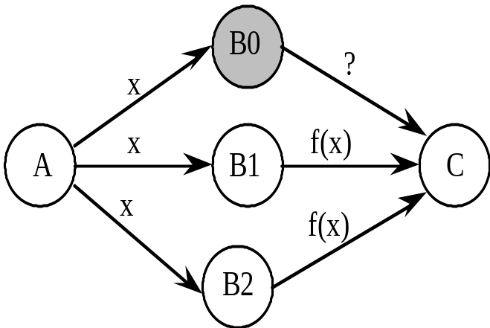
Tolerating crash failures
Triple modular redundancy (TMR) for
masking any single failure. N-modular
redundancy masks up to m failures,
when N = 2m +1
In fact, to deal with crash only, two
modules are adequate. The final
recipient needs only one good data
Take a vote
What if the voting unit fails?

Slide 36
Detection of omission failures
  For FIFO channels: Use sequence numbers with messages.
  (1, 2, 3, 5, 6 … ) ⇒ message 4 is missing
  Non-FIFO bounded delay channels - use timeout
  What about non-FIFO channels for which the upper bound
  of the delay is not known?
  Use unbounded sequence numbers and acknowledgments.
  But acknowledgments may be lost too!
  Let us look how a real protocol deals with omission ….

Slide 37
Tolerating omission failures
A central issue in networking
A
router
Routers may drop messages, but
reliable end-to-end transmission is an
important requirement. If the sender
does not receive an ack within a time period,
it retransmits (it may so happen that the
was not lost, so a duplicate is generated).
This implies, the communication must
tolerate Loss, Duplication, and Re-ordering
of messages
B
router

Slide 38
Replication
Enhances a service by replicating data
  Increased Availability
    Of service. When servers fail or when the network is partitioned.
  Fault Tolerance
    Under the fail-stop model, if up to f of f+1 servers crash, at least one is alive.
  Load Balancing
    One approach: Multiple server IPs can be assigned to the same name in DNS, which returns answers round-robin.
P: probability that one server fails= 1 – P= availability of service. e.g. P = 5% => service is available 95% of the time.
P^{n}: probability that n servers fail= 1 – P^{n}= availability of service. e.g. P = 5%, n = 3 => service available 99.875% of the time

Slide 39
Goals of Replication
Replica Manager
Replication Transparency
  User/client need not know that multiple physical copies of data exist.
Replication Consistency
  Data is consistent on all of the replicas (or is converging towards becoming consistent)
Client
Front End
server
RM
Client
Front End
RM
server
Client
Front End
RM
server
Service

Slide 40
Replication Management
Request Communication
  Requests can be made to a single RM or to multiple RMs
Coordination: The RMs decide
  whether the request is to be applied
  the order of requests
    FIFO ordering: If a FE issues r then r’, then any correct RM handles r and then r’.
    Causal ordering: If the issue of r “happened before” the issue of r’, then any correct RM handles r and then r’.
    Total ordering: If a correct RM handles r and then r’, then any correct RM handles r and then r’.
Execution: The RMs execute the request (often they do this tentatively).

Slide 41
Replication Management
Agreement: The RMs attempt to reach consensus on the effect of the request.
  E.g., Two phase commit through a coordinator
  If this succeeds, effect of request is made permanent
Response
  One or more RMs responds to the front end.
  The first response to arrive is good enough because all the RMs will return the same answer.
  Thus each RM is a replicated state machine
    “Multiple copies of the same State Machine begun in the Start state, and receiving the same Inputs in the same order will arrive at the same State having generated the same Outputs.” [Wikipedia, Schneider 90]

Slide 42
Group Communication: A building block
“Member”= process (e.g., an RM)
Static Groups: group membership is pre-defined
Dynamic Groups: Members may join and leave, as necessary
Group
Address Expansion
Leave
Membership Management
Group Send
Fail
Multicast Comm.
Join

Slide 43
Replication using GC
Client
Front End
server
RM
Client
Front End
RM
server
Client
Front End
RM
server
Service
Need consistent updates to all copies of an object
Linearizability
Sequential Consistency

Slide 44
Linearizability
Let the sequence of read and update operations that client i performs in some execution be o_{i1}, o_{i2},….
  “Program order” for the client
A replicated shared object service is linearizable if for any execution (real), there is some interleaving of operations (virtual) issued by all clients that:
  meets the specification of a single correct copy of objects
  is consistent with the real times at which each operation occurred during the execution
Main goal: any client will see (at any point of time) a copy of the object that is correct and consistent

Slide 45
Sequential Consistency
The real-time requirement of linearizability is hard, if not impossible, to achieve in real systems
A less strict criterion is sequential consistency: A replicated shared object service is sequentially consistent if for any execution (real), there is some interleaving of clients’ operations (virtual) that:
  meets the specification of a single correct copy of objects
  is consistent with the program order in which each individual client executes those operations.
This approach does not require absolute time or total order. Only that for each client the order in the sequence be consistent with that client’s program order (~ FIFO).
Linearilizability implies sequential consistency. Not vice-versa!
Challenge with guaranteeing seq. cons.?
  Ensuring that all replicas of an object are consistent.

Slide 46
Passive Replication
(Primary-Backup)
primary
Request Communication: the request is issued to the primary RM and carries a unique request id.
Coordination: Primary takes requests atomically, in order, checks id (resends response if not new id.)
Execution: Primary executes & stores the response
Agreement: If update, primary sends updated state/result, req-id and response to all backup RMs (1-phase commit enough).
Response: primary sends result to the front end
Client
Front End
RM
RM
Backup
….
RM
Client
Front End
RM
Backup
Backup

Slide 47
Fault Tolerance in Passive Replication
The system implements linearizability, since the primary sequences operations in order.
If the primary fails, a backup becomes primary by leader election, and the replica managers that survive agree on which operations had been performed at the point when the new primary takes over.
  The above requirement can be met if the replica managers (primary and backups) are organized as a group and if the primary uses view-synchronous group communication to send updates to backups.
Thus the system remains linearizable in spite of crashes

Slide 48
Active Replication
Request Communication: The request contains a unique identifier and is multicast to all by a reliable totally-ordered multicast.
Coordination: Group communication ensures that requests are delivered to each RM in the same order (but may be at different physical times!).
Execution: Each replica executes the request. (Correct replicas return same result since they are running the same program, i.e., they are replicated protocols or replicated state machines)
Agreement: No agreement phase is needed, because of multicast delivery semantics of requests
Response: Each replica sends response directly to FE
Client
Front End
RM
….
RM
Client
Front End
RM

Slide 49
FT via Active Replication
RMs work as replicated state machines, playing equivalent roles. That is, each responds to a given series of requests in the same way. One way of achieving this is by running the same program code at all RMs (but only one way – why?).
If any RM crashes, state is maintained by other correct RMs.
This system implements sequential consistency
  The total order ensures that all correct replica managers process the same set of requests in the same order.
  Each front end’s requests are served in FIFO order (because the front end awaits a response before making the next request).
So, requests are FIFO-total ordered.
Caveat (Out of band): If clients are multi-threaded and communicate with one another while waiting for responses from the service, we may need to incorporate causal-total ordering.

Slide 50
Backward vs. forward error recovery
Backward error recovery
When safety property is violated, the computation rolls back and resumes from a previous correct state.
time
rollback
Forward error recovery
Computation does not care about getting the history right, but moves on, as long as eventually the safety property is restored.
True for self-stabilizing systems.

Slide 51
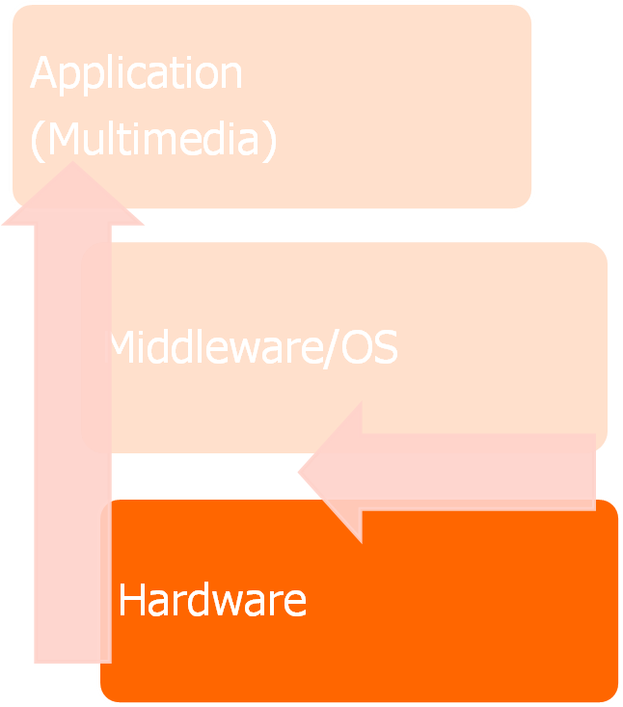
Conventional Protection for Caches
Cache is the most hit by soft errors
Conventional Protected Caches
  Unaware of fault tolerance at applications
  Implement a redundancy technique such as ECC to protect all data for every access
    Overkill for multimedia applications
  ECC (e.g., a Hamming Code) incurs high performance penalty by up to 95%, power overhead by up to 22%, and area cost by up to 25%
Unaware of Application
High Cost
Cache
ECC
Notes:
High expensive conventional techniques for caches.

Slide 52

PPC (Partially Protected Caches)
Observation
  Not all data are equally failure critical
    Multimedia data vs. control variables
Propose PPC architectures to provide an unequal protection for mobile multimedia systems [Lee, CASES06][Lee, TVLSI08]
  Unprotected cache and Protected cache at the same level of memory hierarchy
  Protected cache is typically smaller to keep power and delay the same as or less than those of Unprotected cache
PPC
Unprotected
Cache
Protected
Cache
Memory
Notes:
Based on observation, we have proposed PPC architecture, which is implemented with different levels of protection.

Slide 53
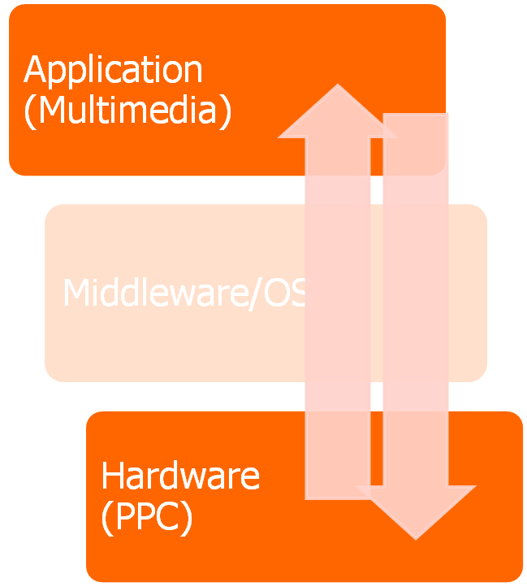
PPC for Multimedia Applications
Unprotected
Cache
PPC
Protected
Cache
Memory
Propose a selective data protection [Lee, CASES06]
Unequal protection at hardware layer exploiting error-tolerance of multimedia data at application layer
Simple data partitioning for multimedia applications
  Multimedia data is failure non-critical
  All other data is failure critical
Power/Delay Reduction
Fault Tolerance

Slide 54
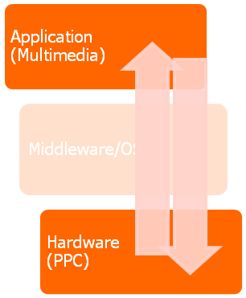
PPC for general purpose apps
All data are not equally failure itical
Propose a PPC architecture to provide unequal protection
  Support an unequal protection at hardware layer by exploiting error-tolerance and vulnerability at application
DPExplore [Lee, PPCDIPES08]
  Explore partitioning space by exploiting vulnerability of each data page
Vulnerable time
  It is vulnerable for the time when eventually it is read by CPU or written back to Memory
Pages causing high vulnerable time are failure critical
Application Data & Code
Error-tolerance of MM data
Vulnerability of Data & Code
Page Partitioning Algorithms
Failure Non-Critical
Failure Critical
FNC & FC are mapped into Unprotected & Protected Caches
Unprotected Cache
Protected Cache
PPC

Slide 55
CC-PROTECT
Approach which cooperates existing schemes across layers to mitigate the impact of soft errors on the failure rate and video quality in mobile video encoding systems
  PPC (Partially Protected Caches) with EDC (Error Detection Codes) at hardware layer
  DFR (Drop and Forward Recovery) at middleware
  PBPAIR (Probability-Based Power Aware Intra Refresh) at application layer
Demonstrate the effectiveness of low-cost (about 50%) reliability (1,000x) at the minimal cost of QoS (less than 1%)
Application
PBPAIR -
Error Resilience
Middleware/ OS
DFR -
Error Correction
ECC
EDC
Hardware
Unprotected
Cache
Protected
Cache

Slide 56









CC-PROTECT
Mobile Video Application
Error-prone Networks
Original
Video
Error-Controller
(e.g., frame drop)
Error-Resilient
Encoder (e.g., PBPAIR)
Frame Drop
Packet Loss
Error-
Aware
Video
Error-Aware Video Encoder (EAVE)
QoS Loss
Monitor &
Translate SER
Trigger
Selective DFR
Support
EAVE & PPC
BER (Backward
Error Recovery)
DFR (Drop &
Forward Recovery)
Error-prone Networks
Soft
Error
MW/OS
Feedback
Mobile Video Application
Parameter
frame K
frame K+1
Unprotected
Cache
Protected
Cache
EDC
Error detection
PPC

Slide 57
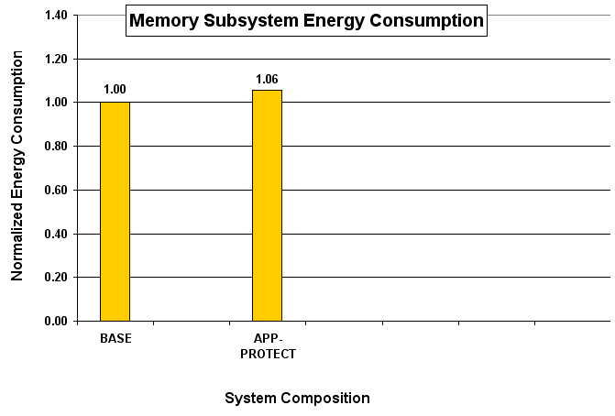
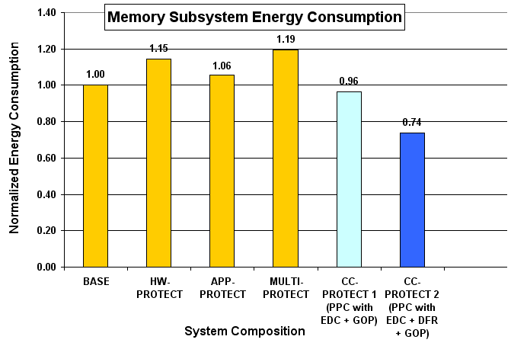
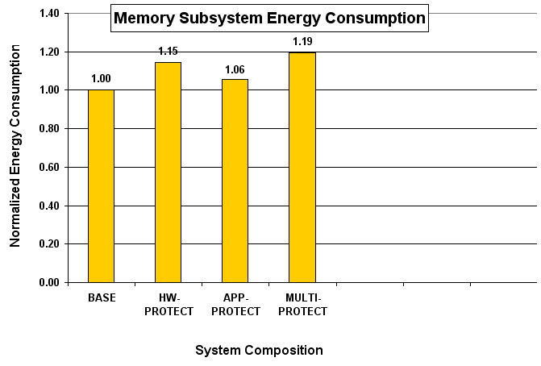
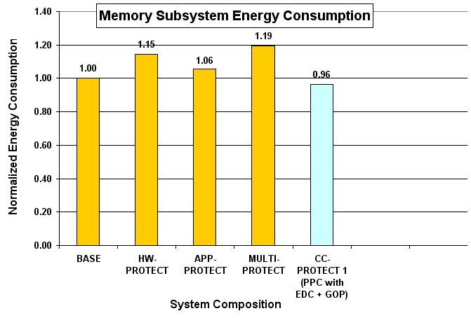
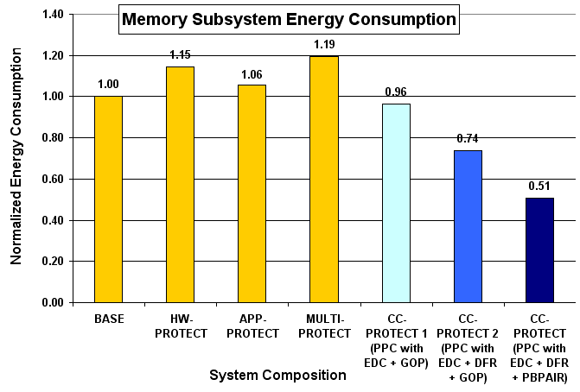
Energy Saving
Application
(Error-Prone or
Error-Resilient)
EDC + DFR impact
36% Reduction compared to HW-PROTECT
26% Reduction compared to BASE
EDC + DFR + PBPAIR(CC-PROTECT) impact
56% Reduction compared to HW-PROTECT
49% Reduction compared to BASE
EDC impact
17% Reduction compared to HW-PROTECT
4% Reduction compared to BASE
Hardware
(Unprotected
or Protected)
BASE = Error-prone video encoding + unprotected cache
HW-PROTECT = Error-prone video encoding + PPC with ECC
APP-PROTECT = Error-resilient video encoding + unprotected cache
MULTI-PROTECT = Error-resilient video encoding + PPC with ECC
CC-PROTECT1 = Error-prone video encoding + PPC with EDC
CC-PROTECT2 = Error-prone video encoding + PPC with EDC + DFR
CC-PROTECT = error-resilient video encoding + PPC with EDC + DFR

Slide 58
4) Checkpoints & Rollbacks
Checkpoints and Rollbacks
  Checkpoint
    A copy of an application’s state
    Save it in storage immune to the failures
  Rollback
    Restart the execution from a previously saved checkpoint
  ➔ Recover from transient and permanent hardware and software failures
Data
Producer A
Consumer
Application
State K
state (K-1)
state K
Rollback
fault
Checkpoint
Notes:
Checkpoint and rollback is a coordinated scheme. Every interval it saves a copy of application’s state (such as program counter and memory address) to the safe storage from the failures. If failure occurs, the application’s state is rolled back to the last saved checkpoint and it restarts from there.
In this case that fault happens at application in producer A.
Every interval application saves state to the green-colored storage.
After state K, fault occurs then state is rolled back to the state K and restarts the application.

Slide 59
Message Logging
  Tolerate crash failures
  Each process periodically records its local state and log messages received after
    Once a crashed process recovers, its state must be consistent with the states of other processes
    Orphan processes
      surviving processes whose states are inconsistent with the recovered state of a crashed process
    Message Logging protocols guarantee that upon recovery no processes are orphan processes

Slide 60
Message logging protocols
  Pessimistic Message Logging
      avoid creation of orphans during execution
      no process p sends a message m until it knows that all messages delivered before sending m are logged; quick recovery
      Can block a process for each message it receives - slows down throughput
      allows processes to communicate only from recoverable states; synchronously log to stable storage any information that may be needed for recovery before allowing process to communicate

Slide 61
Message Logging
  Optimistic Message Logging
      take appropriate actions during recovery to eliminate all orphans
      Better performance during failure-free runs
      allows processes to communicate from non-recoverable states; failures may cause these states to be permanently unrecoverable, forcing rollback of any process that depends on such states

Slide 62
Causal Message Logging
  Causal Message Logging
      no orphans when failures happen and do not block processes when failures do not occur.
      Weaken condition imposed by pessimistic protocols
      Allow possibility that the state from which a process communicates is unrecoverable because of a failure, but only if it does not affect consistency.
      Append to all communication information needed to recover state from which communication originates - this is replicated in memory of processes that causally depend on the originating state.

Slide 63
KAN – A Reliable Distributed Object System (UCSB)
Goal
  Language support for parallelism and distribution
  Transparent location/migration/replication
  Optimized method invocation
  Fault-tolerance
  Composition and proof reuse
Log-based forward recovery scheme
  Log of recovery information for a node is maintained externally on other nodes.
  The failed nodes are recovered to their pre-failure states, and the correct nodes keep their states at the time of the failures.
Only consider node crash failures.
  Processor stops taking steps and failures are eventually detected.

Slide 64
Basic Architecture of the Fault Tolerance Scheme
Physical Node i
Logical Node x
Logical Node y
Fault Detector
Failure handler
External
Log
Request handler
Communication Layer
IP Address
Network

Slide 65
Egida (UT Austin)
An object-oriented, extensible toolkit for low-overhead fault-tolerance
Provides a library of objects that can be used to compose log-based rollback recovery protocols.
    Specification language to express arbitrary rollback-recovery protocols
    Checkpointing
      independent, coordinated, induced by specific patterns of communication
    Message Logging
      Pessimistic, optimistic, causal

Slide 66
AQuA
Adaptive Quality of Service Availability
Developed in UIUC and BBN.
Goal:
  Allow distributed applications to request and obtain a desired level of availability.
Fault tolerance
  replication
  reliable messaging

Slide 67
Features of AQuA
Uses the QuO runtime to process and make availability requests.
Proteus dependability manager to configure the system in response to faults and availability requests.
Ensemble to provide group communication services.
Provide CORBA interface to application objects using the AQuA gateway.

Slide 68
Group structure
  For reliable mcast and pt-to-pt. Comm
    Replication groups
    Connection groups
    Proteus Communication Service Group for replicated proteus manager
      replicas and objects that communicate with the manager
      e.g. notification of view change, new QuO request
      ensure that all replica managers receive same info
    Point-to-point groups
      proteus manager to object factory

Slide 69
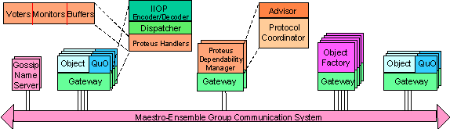
AQuA Architecture

Slide 70
Fault Model, detection and Handling
  Object Fault Model:
    Object crash failure - occurs when object stops sending out messages; internal state is lost
      crash failure of an object is due to the crash of at lease one element composing the object
    Value faults - message arrives in time with wrong content (caused by application or QuO runtime)
      Detected by voter
    Time faults
      Detected by monitor
    Leaders report fault to Proteus; Proteus will kill objects with fault if necessary, and generate new objects

Slide 71
5) Recovery Blocks
Recovery Blocks
  Multiple alternates to perform the same functionality
    One Primary module and Secondary modules
    Different approaches
  Select a module with output satisfying acceptance test
  Recovery Blocks and Rollbacks
    Restart the execution from a previously saved checkpoint with secondary module
  ➔Tolerate software failures
Data
Producer A
Consumer
Application
Block X
Block X2
Block Y
Block Z
state (K-1)
state K
Rollback
fault
Checkpoint
Notes:
Recovery blocks provide multiple alternates to perform the same functionality using different approaches or algorithms. Basic approach is to select a module satisfying the quality after acceptance test from primary module to secondary modules. Another possible scheme is recovery blocks and rollbacks. This is the same as checkpoints and rollbacks except restarting with secondary module instead of primary module.
If fault is detected at block X in application,
Then rollback the state to the previous one at K and restart it with the secondary block X2 not primary block X.
(For example, diamond search algorithm and full search algorithm are different approaches to perform motion estimation in MPEG video encoding.)
(The main difference between recovery blocks and N-version programming is recovery blocks is applying the different algorithms even by the same programmer. On the other hand, N-version programming is implemented by different programming teams.)
(WHAT is DIFFERENCE between Modular Redundancy, N-version programming, and Recovery Blocks?)
They all use redundancy basically. But if we insist that we differentiate between modular redundancy, n-version programming, and recovery blocks, then modular redundancy is to use identical modules and n-version programming to use different modules by different programmers but recovery blocks is to use different blocks with various algorithms.

